Slide 1
crudbywithoutrest
Performing Database CRUD
operations by using web API with out REST Framework
Retrieve operations, Status codes and searlizers

Slide 2
1.Add testapp to setting.py
2. Modelclas
3.Migrations
4.admin.py
5.superuser

Slide 3
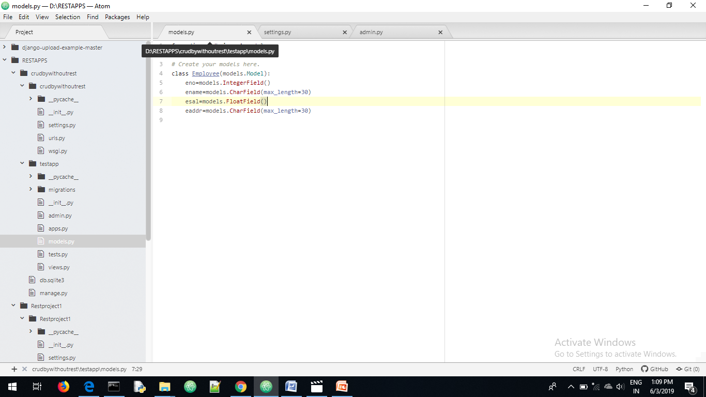
Models.py

Slide 4
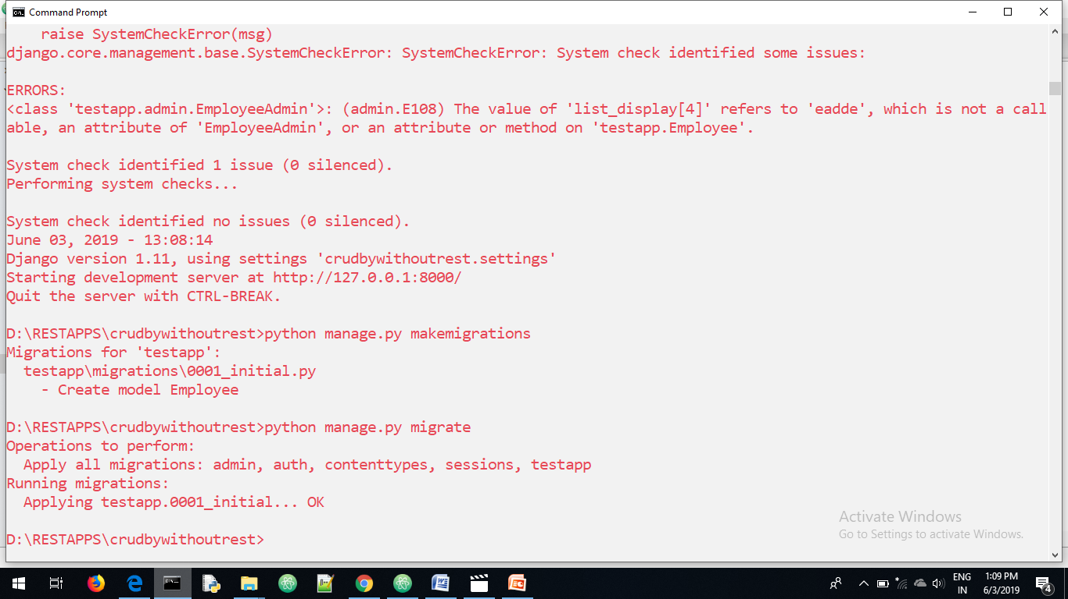
migrations

Slide 5
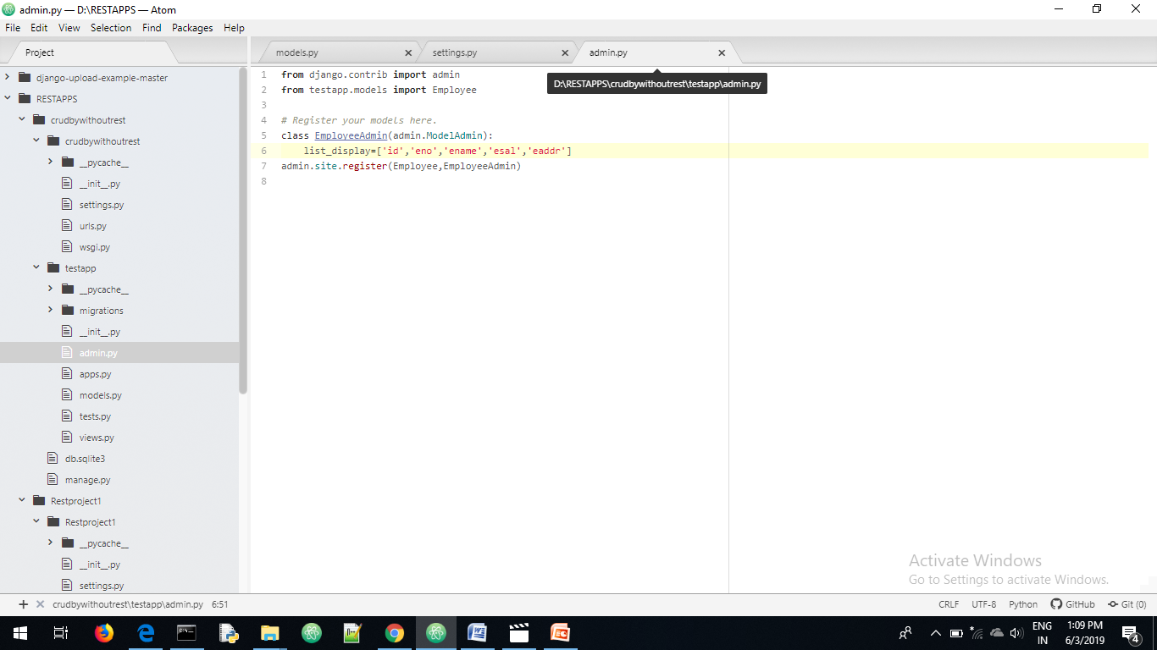
Admin.py

Slide 6
superuser

Slide 7
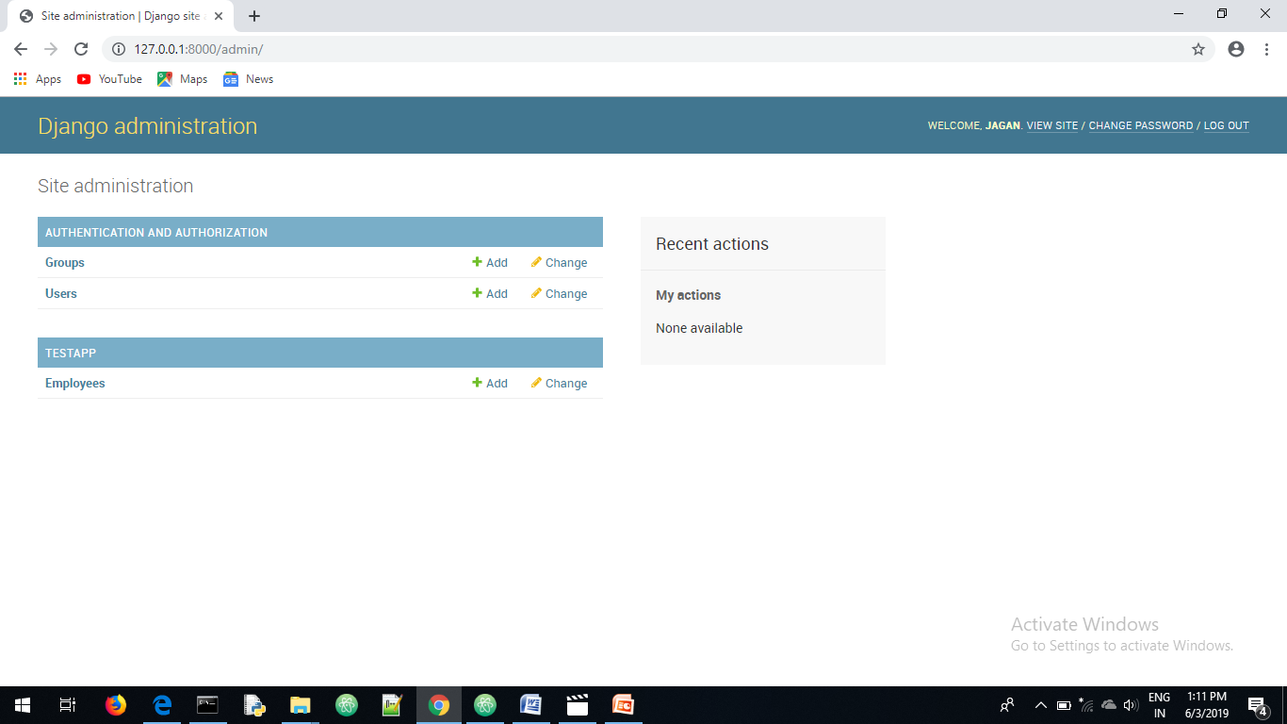

Slide 8
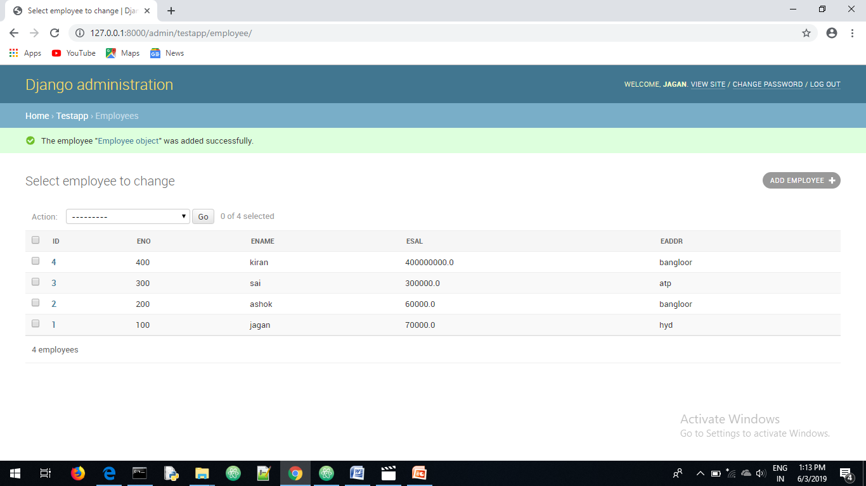
Insert data manually

Slide 9
Performing Retrieve operation
Ways of getting data
Get a particular record based on matched id
Or
2.Get all records

Slide 10
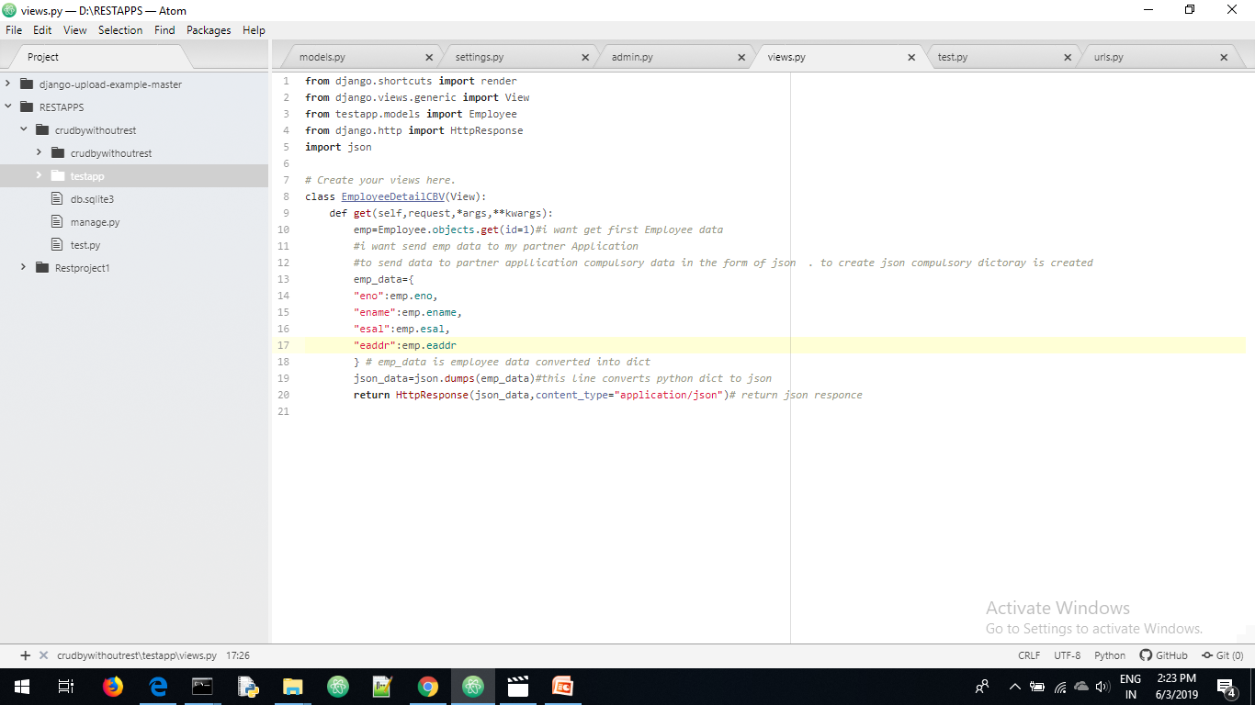
Views.py

Slide 11
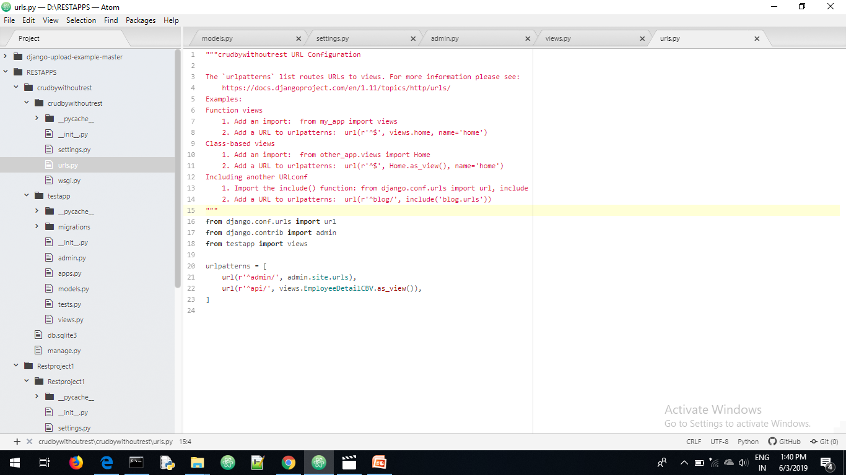
Urls.py

Slide 12
Status codes
Status code means response from server
1xx->1 to 199-→Information
2xx→200 to 299-→successful
3xx-→300 to 399-→Redirection
4xx-→400 to 499→client Error (Eg:pagenot found)
5xx-→500 to 599 -→Server Error
these are status codes

Slide 13
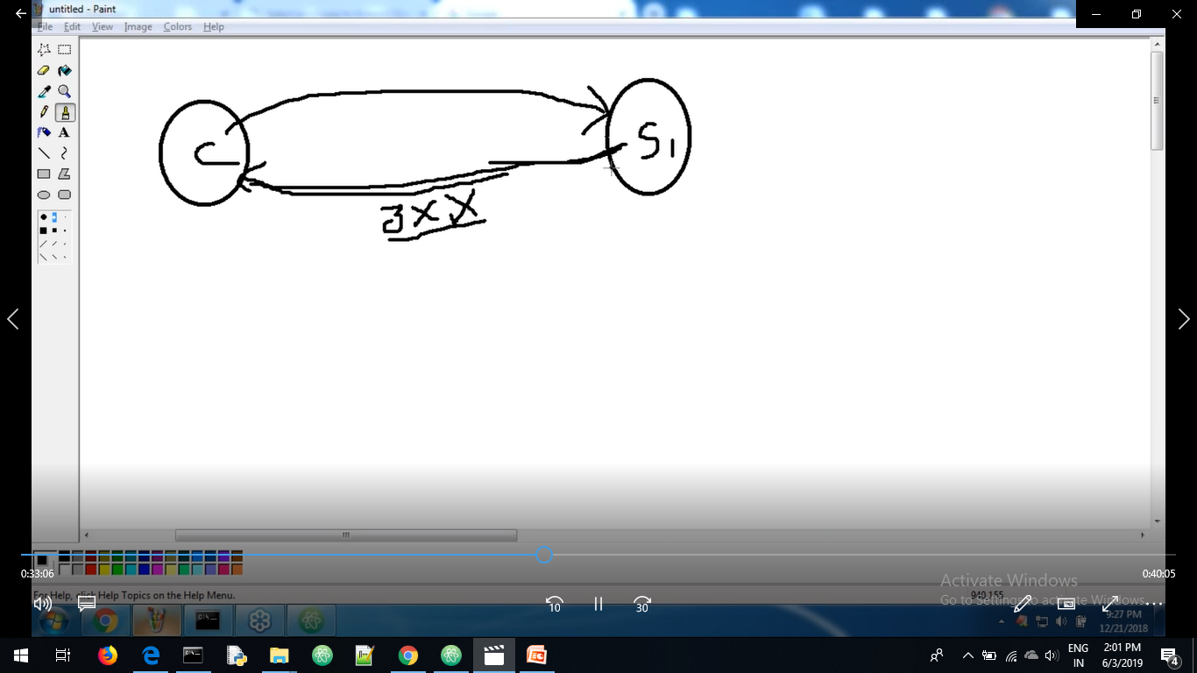

Slide 14
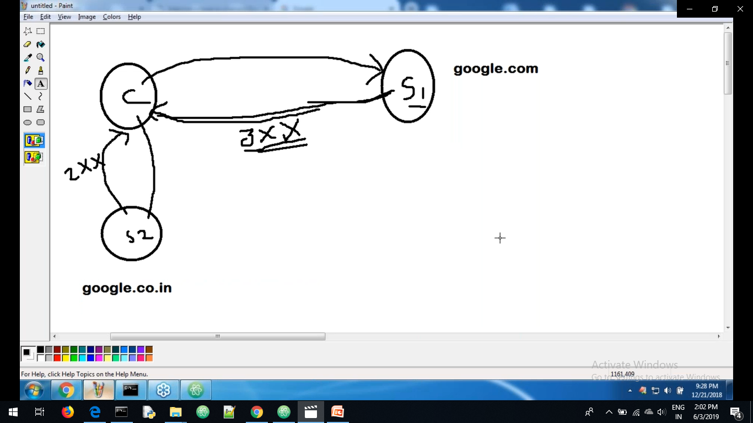
Redirect 3xx means redirect

Slide 15
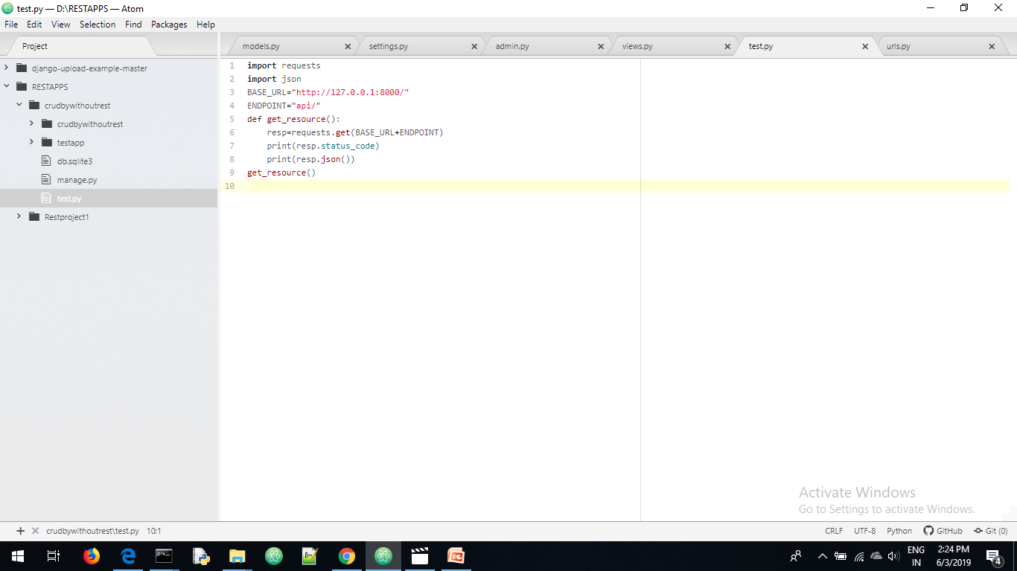
Test.py API

Slide 16
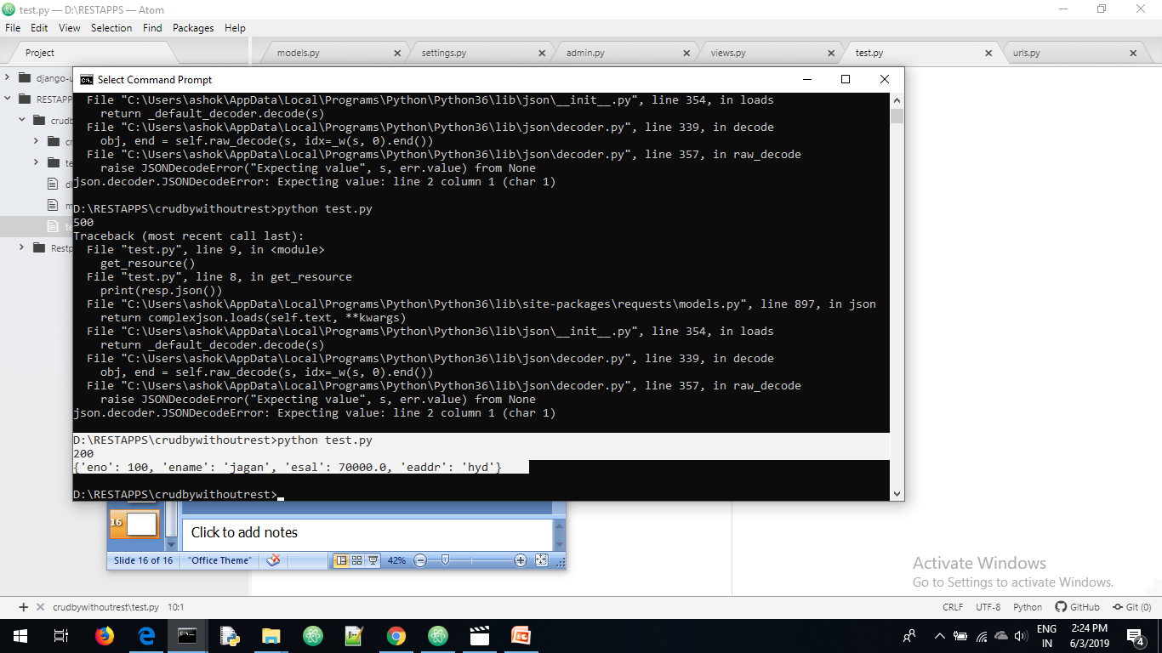
Sending get response from API

Slide 17
I am passed id from API get corresponding info from server
I am passed id from API get corresponding info from server

Slide 18
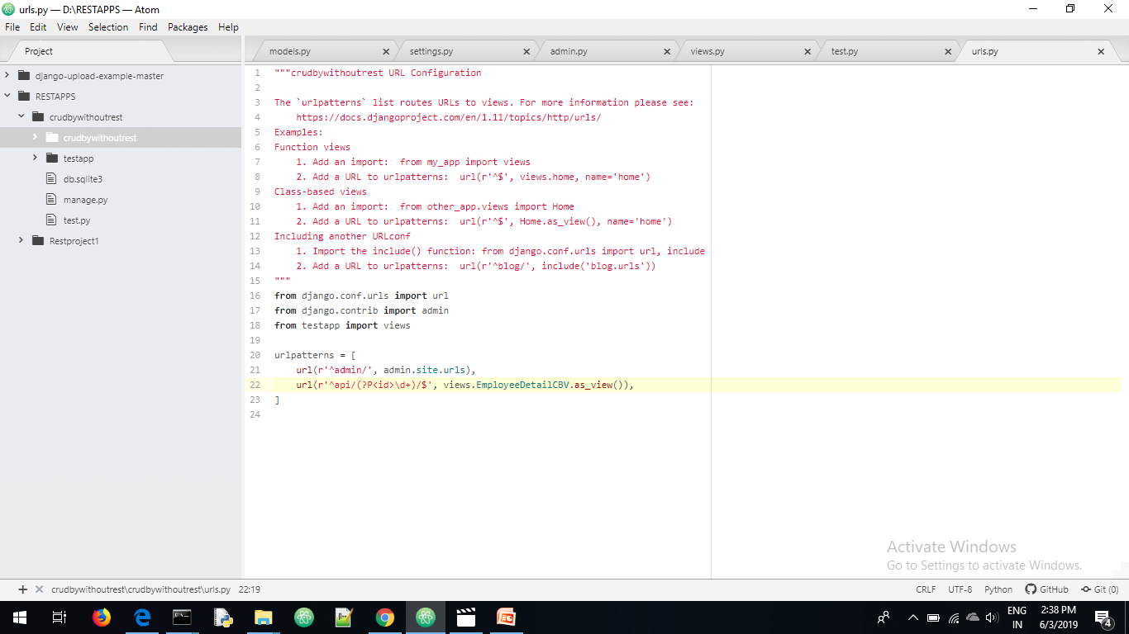
Urls.py
url(r'^api/(?P<id>\d+)/$',views.EmployeeDetailCBV.as_view()),

Slide 19
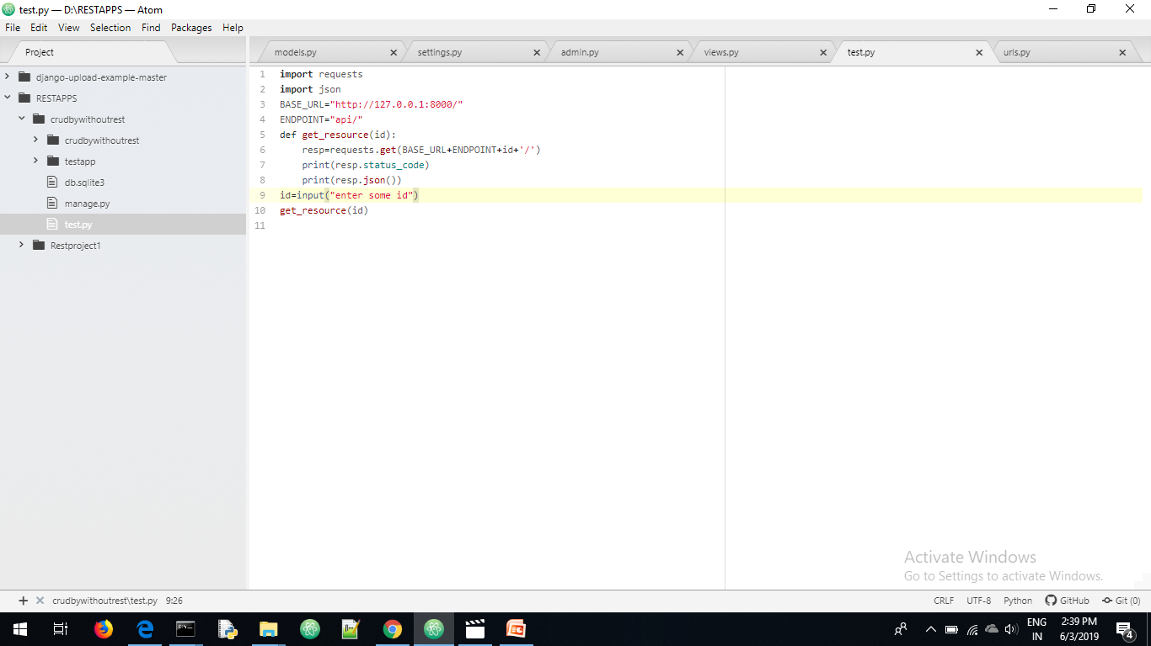
Api test.py

Slide 20
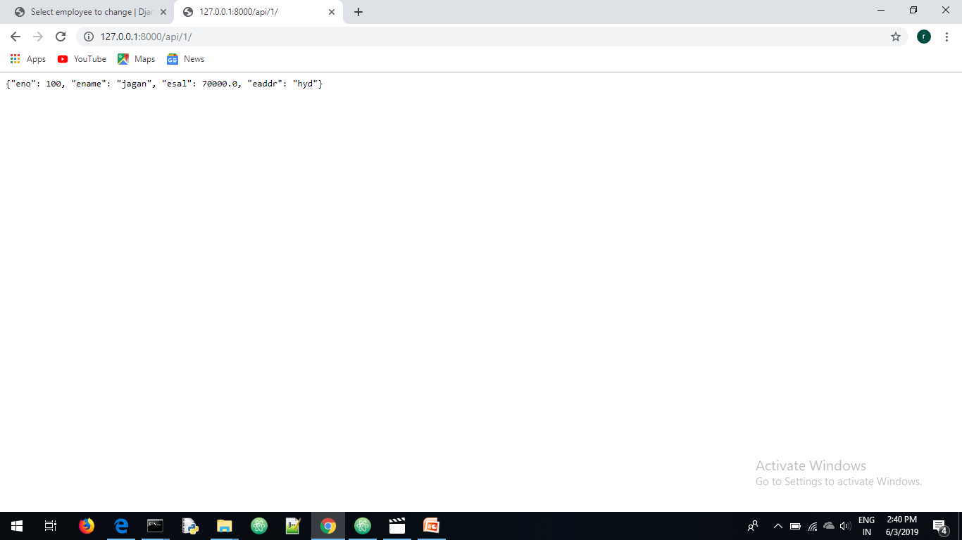

Slide 21
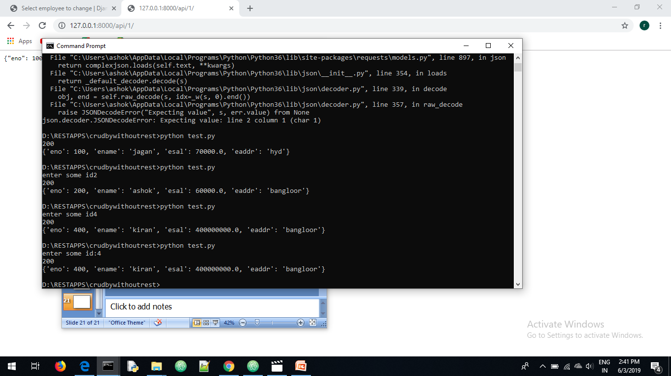
API request sending from API

Slide 22
serialization
Converting an object one form to another form is known as serialization
Example of serialization python dict converting into json data

Slide 23
To convert one employee record python dict to json data is possible.
For example so many employee records are there how can we convert that list records it is difficult .
For that serializes is module there in that serialize () method is available which convert one form of objects to another form
Example
Json_data=serializers.serialize(‘json’,qs)-→ total qurey set conveted into json

Slide 24
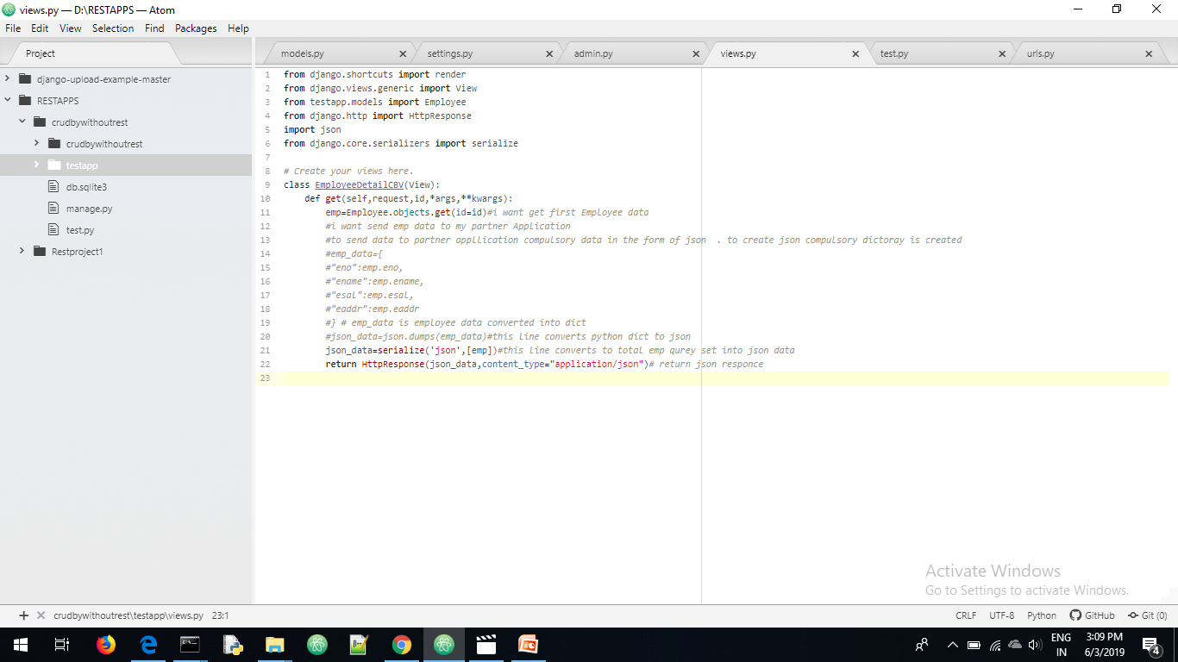
Views.py

Slide 25

API

Slide 26
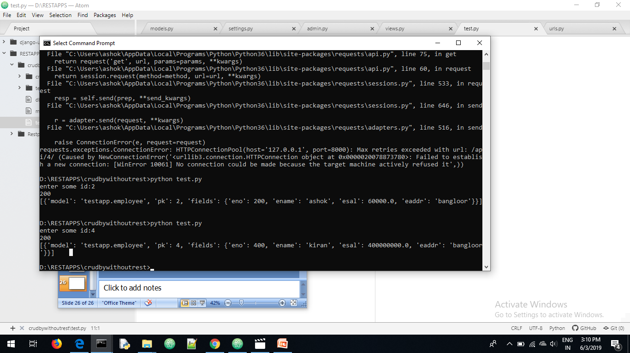

Slide 27
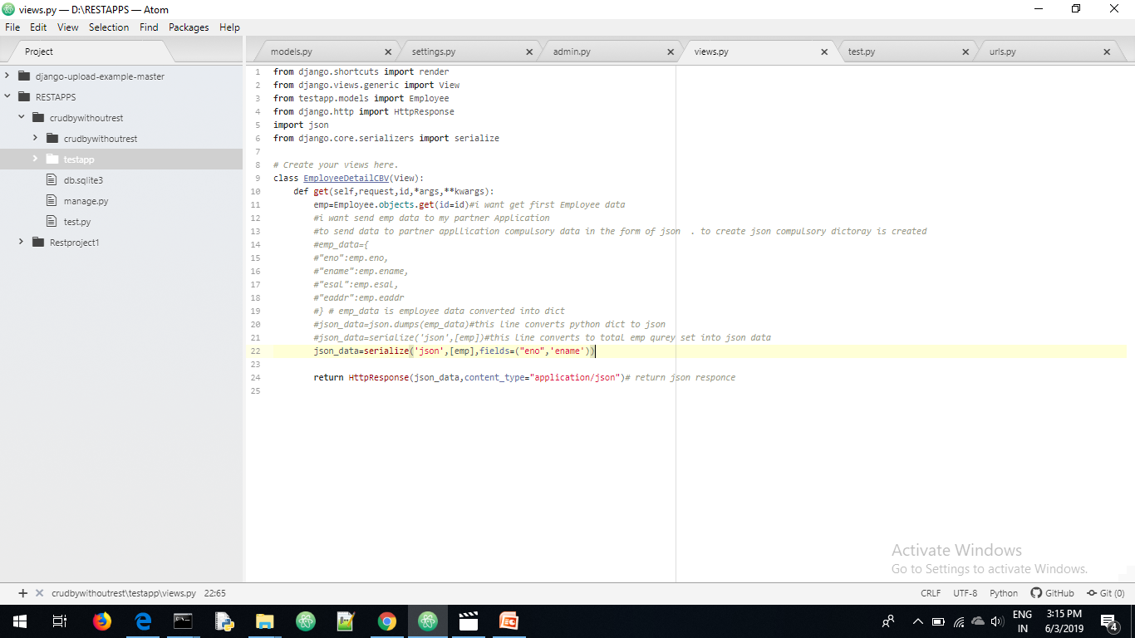
I want only eno and ename

Slide 28
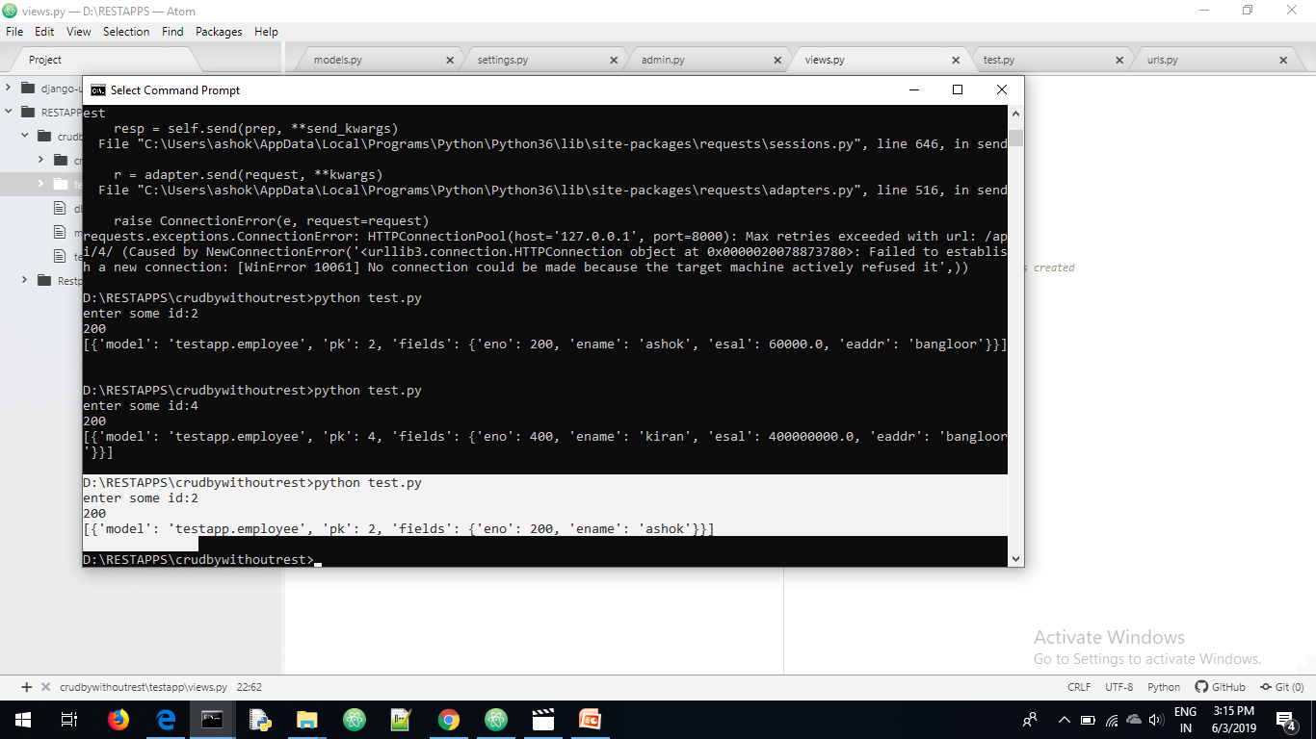

Slide 29
https://drive.google.com/open?id=10bZWePzx-A6t9RPkcOOVm1IPXel-TX3R

